Slide 1
A Comparison Algorithms for Sensing the Spectrum Using Deep Learning Techniques

Slide 2
CONTENTS
Abstract
Introduction
Cognitive Radio
Spectrum Sensing Techniques
Existing method
Drawbacks
Proposed approach
Advantages
Results
Conclusion
References

Slide 3
ABSTRACT
In 5G Wireless communications Spectrum sensing is a key function of cognitive radio to prevent the harmful interference with licensed users and identify the available spectrum for improving the spectrum’s utilization. In this paper a deep learning-based approach is introduced to sense the spectrum for availability of the primary user. If the primary user is absence, then a secondary user can be allocated in the spectrum. In ultra-dense networks and in dense network traffic conditions there is a scope for continuous utilization of the spectrum by the licensed user. Along with this approaches we will implement spectrum sensing using Energy detection technique, Entropy technique, optimized features. Telecommunications can expand its services to huge volume of users without any disturbances. This process will show better results when compared to state of art methods.

Slide 4
INTRODUCTION
Modern wireless systems offering a wide variety of high data rate applications to various users at the same time.
In order to realize this objective, they have to overcome the practical constraints imposed by the resources they need such as power and spectrum, which are limited in nature.
The number of wireless systems is increasing very fastly, the scarcity of these resources, especially of the frequency spectrum, becomes a problem day by day.
Cognitive radio is a concept that overcome to the problem by proposing an opportunistic spectrum usage approach, in which frequency bands that are not being used by their licensed users are utilized by cognitive radios.
Since cognitive radios do not need a license and they do not affect the operation of licensed systems, this approach leads to a highly economic and efficient usage of the frequency spectrum.

Slide 5
Basic function of cognitive radio is to sense the spectrum precisely by evading any chances of hindrance or interference to primary or licensed users.
By using spectrum sensing, cognitive radios can adapt themselves to the eternal wireless network.
Here primary user (PU) can be defined as the user who has license to use a specific band of the spectrum.
On the other hand, secondary users (SU) do have license to use the spectrum but can use the spectrum when PU is absent.
When PU is present SU user shift its transmission to another frequency or changes other modulation parameters and never causes interference to primary users.
Various techniques have been used for identifying the presence of the PU signal transmission.
Among them, energy detection has been mostly applied because it does not require any a priori knowledge of the primary signals and has much lower complexity than the other two schemes.
In addition, it does not need any prior information about the PUs' signals.

Slide 6
COGNITIVE RADIO
A Cognitive Radio is a adaptive multi-dimensionally aware intelligent wireless communication system that learn from its experience to reason, plan and decide future action to meet consumer needs .
The two important characteristics of cognitive radio are:-
Cognitive capability- Cognitive capability refers to the ability of the cognitive radio technology to capture or sense the information from its radio environment.
(b)Re-configurability- Re-configurability enables the cognitive radio to be programmed dynamically according to the radio environment. Cognitive Radio mainly does four functions

Slide 7
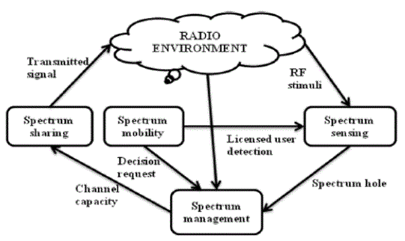
Fig 1: Basic cognitive cycle

Slide 8
Spectrum Sensing: Cognitive Radio continuously looks for the unused spectrum which is known as the spectrum hole. This property of cognitive radio is termed as spectrum sensing.
Spectrum Management: Once the spectrum holes found cognitive radio selects the available hole or channel. This property of cognitive radio is termed as spectrum management.
Spectrum Sharing: Cognitive Radio allocates the unused spectrum (spectrum hole) to the secondary (cognitive) user as long as primary user does not need it. This property of cognitive radio is termed as spectrum sharing.
Spectrum Mobility: Cognitive Radio vacates the channel when a licensed (Primary) user is detected. This property of cognitive radio is termed as the spectrum mobility

Slide 9
SPECTRUM SENSING TECHNIQUES
There are various spectrum sensing techniques which are employed for spectrum sensing such as:-
(1) Matched Filter Detection: The matched filter (also referred to as coherent detector), it can consider as a best sensing technique if CR has knowledge of PU. It is very accurate because it maximizes the received signal-to-noise ratio (SNR). Matched filter correlates the signal with time shifted version and compares between the final output of matched filter and predetermined threshold will determine the PU presence. Hence, if this information is not accurate, then the matched filter operates weakly.
(2) Cyclostationary Feature Detection: Implementation of a Cyclostationary feature detector is a spectrum sensing which can differentiate the modulated signal from the additive noise. A signal is said to be Cyclostationary if its mean and autocorrelation are a periodic function. Cyclostationary feature detection can distinguish PU signal from noise, and used at very low Signal to Noise Ratio (SNR) detection by using the information present in the PU signal that are not present in the noise.

Slide 10
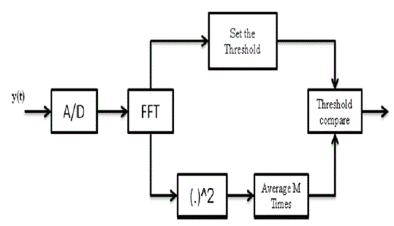
(3) Energy Detection: Energy detector is the most popular way of spectrum sensing because of its low computational and implementation complexities. The receivers do not need any knowledge about the primary users. An energy detector (ED) simply treats the primary signal as noise and decides on the presence or absence of the primary signal based on the energy of the observed signal.. Digital implementations using FFT-based spectral estimates. Fig. 2 shows the architecture for digital implementation of an energy detector .
Fig 2: Energy Detector

Slide 11
EXISTING METHOD
In previous detection techniques, the performance is acceptable, whose entropy is calculated from the amplitude spectrum.
The result is robust to noise uncertainty. In this work, the entropy is calculated using histogram.
Threshold is calculated, Probability of detection is calculated by comparing this threshold with the entropy of H1 and H0 and based on this comparison the spectrum is sensed.
The performance of spectrum sensing is evaluated by a metric: The Probability of detection Pd.
The Pd quantifies the ability to correctly detecting the presence of a primary signal.

Slide 12
DRAWBACKS
Probability of detection is low.
Computational complexity is high.
Accuracy is low.
Only spectrum is sensed and the results are not accurate as we based on thresholding concept.

Slide 13
PROPOSED APPROACH
We propose this “A comparison algorithms for sensing the spectrum using deep learning techniques” to overcome all the drawbacks in existing system.
With this project we can sense the spectrum for finding the presence of primary user.
As, the spectrum sensing process is majorly focused on the checking the availability of primary users and through cognitive radio assigning the secondary users.
As the network traffic is increasing day by day and the users utilizing the spectrum is also increasing then it seems difficult to allocate the spectrum to the users and their raises issues in the signal strength.
To reduce these issues, we propose a new system which of sensing the spectrum using energy detection, entropy, optimized features and deep learning features.

Slide 14
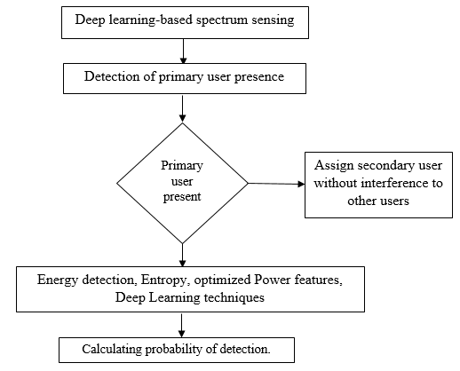
Block diagram:

Slide 15
ADVANTAGES
More number of users can utilize the spectrum.
Signal strength increase as due to reduction in interference.
Scams will be reduced as the spectrum is allocated for all the users.
Cross talks and interference with other users can be reduced.
Enhance user experience.
Helps in establishing the emergency networks.
Increases the efficiency in spectrum utilization.

Slide 16
REFERENCES
[1] N. Kaabouch and W. C. Hu, Handbook of research on software-defined and cognitive radio technologies for dynamic spectrum management. IGI Global,2014.
[2] A. Ali and W. Hamouda, “Advances on Spectrum Sensing for Cognitive Radio Networks: Theory and Applications,” IEEE Commun. Surv. Tutorials, pp. 1–1, 2016.
[3] Y. Zeng, Y.-C. Liang, A. T. Hoang, and R. Zhang, “A Review on Spectrum Sensing for Cognitive Radio: Challenges and Solutions,” EURASIP J. Adv. Signal Process., vol. 2010, pp. 1–16, 2010.
[4] A. Ranjan, Anurag, and B. Singh, “Design and analysis of spectrum sensing in cognitive radio based on energy detection,” International Conference on Signal and Information Processing, 2016, pp. 1–5.
[5] R. T. Khan, M. I. Islam, S. Zaman, and M. R. Amin, “Comparison of cyclostationary and energy detection in cognitive radio network,” International Workshop on Computational Intelligence, 2016, pp. 165–168.

Slide 17
THANKING YOU

